Slide 1
Teaching Information Literacy and Navigating Media Bias
Notes:
Introduce ourselves

Slide 2

Take A Moment…
https://www.youtube.com/watch?v=NB3NPNM4xgo
Debrief
Notes:
S - T-Mobile ad

Slide 3
Why?
In our current media/digital/online environment, individuals are surrounded more than ever by constant exposure to advertising, 24-hour news cycles, and an ever-expanding array of information and entertainment media.
Misinformation, disinformation, partisanship and conspiracy theories are part of the mainstream media.
The emotional content as well as the volume of messages in daily lives makes it difficult to recognize propaganda over truth.
Notes:
S - For the purposes of our presentation, we will be focusing on advertising media and propaganda.

Slide 4
Why Is This Important?
Individuals may not recognize how media is influencing their emotions, attitudes, knowledge and behavior.
“…when you take information from a given source, it will almost inevitably carry with it at least some of the preferences, assumptions, and biases –conscious or not– of the people who produce and disseminate it” (Lunsford, 2016, p.428).
By entering into the conversation, students are invited to utilize critical thinking as part of being an informed citizen of the 21st century.
Notes:
Sheliah

Slide 5
Terminology
Media Bias: Media bias is the bias of journalists and news producers in the selection of events and stories that are reported, and how they are covered.
Propaganda: information, especially of a biased or misleading nature, used to promote or publicize a particular political cause or point of view.
Evidence: the available body of facts or information indicating whether a belief or proposition is true or valid.
Perspective: a particular attitude toward or way of regarding something; a point of view.
(What role does this play? Influenced by culture, social norms, religious views, socio-economic factors, environment, etc…)
False narrative
Fake news
Notes:
Sheliah

Slide 6
Why Are Visuals So Effective?
“…images [are used] to engage viewers and persuade them to accept a particular idea or point of view” (www.sjsu.edu/people/julie.hawker/courses/c1/s2/Visual-Argumentation-Slides.ppt).
“Visual argument is advertising, comics, or anything of that sort used to draw the audiences in” (https://english106spring2009.wordpress.com/what-is-visual-argument/).
Frequently appeals to ethos, pathos, and/or logos.
Notes:
Tracy -
Ethos – credibility & trustworthiness
Pathos – emotional appeal
Logos – reason, evidence & logic

Slide 7
Evaluation Of Visual Media
Is the evidence accurate and adequate?
Visual information can be distorted or manipulated just as words can.
Analyze visual evidence to be sure it’s fair, precise, and credible.
Visual evidence should be relevant and adequate.
It should avoid sensational or purely emotional effect.
(www.sjsu.edu/people/julie.hawker/courses/c1/s2/Visual-Argumentation-Slides.ppt)
Notes:
Tracy

Slide 8
Don’t Accept Visual Arguments At Face Value
Visual arguments are powerful tools of persuasion that appear in a myriad of forms in our media culture.
Evaluate them by examining their claims, weighing the evidence offered in support of those claims, and by exploring the unstated claims (premises), assumptions the arguer makes about the target audience and their particular belief systems.
(www.sjsu.edu/people/julie.hawker/courses/c1/s2/Visual-Argumentation-Slides.ppt)
Notes:
Tracy

Slide 9
Discussing Propaganda
How do you create a classroom environment that is safe for respectful communication?
Notes:
T - Obviously this is a very emotional topic and students may be quick to respond in an inappropriate manner. Topics such as BLM, Abortion, Social Justice can be divisive. Therefore, the ground work needs to be set by the professor before facilitating the discussion.

Slide 10
Respectful Communication
R= take RESPONSIBILITY for what you say and feel without blaming others
E = use EMPATHETIC listening
S= be SENSITIVE to differences in communication styles.
P= PONDER what you hear and feel before you speak.
E= EXAMINE your own assumptions and perceptions.
C= keep CONFIDENTIALITY
T= TRUST ambiguity because we are not here to debate who is right or
wrong. (https://www.kscopeinstitute.org/)
Notes:
T – Tell an anecdote for class about gun control incident in ENG 102. What happens in the classroom stays in the classroom.

Slide 11
Lights, camera, action!
Design
  Objectives, goals
  Caution: Recognize your own bias
Prepare the class/students:
  Safe environment
  Ground rules
  Remember, it’s the topic NOT the person
Roll ‘em
  Identify topic or allow students to choose
  Provide samples of resources, outlines, etc..
Coach/facilitate; don’t dictate
Notes:
S - Give topic example

Slide 12
Mind Over Media Resource
https://propaganda.mediaeducationlab.com/
https://mediaeducationlab.com/sites/default/files/FINAL%20Mind%20Over%20Media%209.17.18.pdf
Notes:
Sheliah

Slide 13
The Debate Over Propaganda
Is it propaganda or not?
Perspective plays a role.
Are public health announcements propaganda?
Can elements of propaganda be used for the “good”?
Notes:
Tracy – give some examples of perspective and propaganda

Slide 14
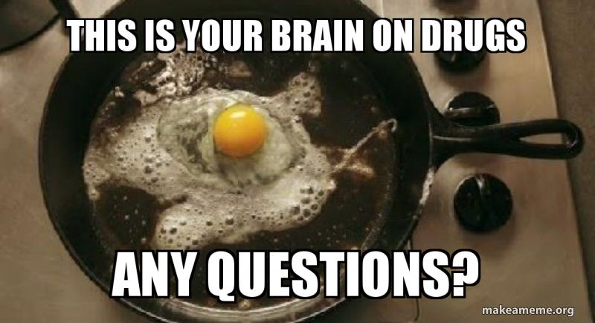
Is It Propaganda?
Notes:
S - Some additional topics and ideas…. Change to comparison of one that is more….try vaccination. Is a public service announcement propaganda?

Slide 15
Reality Or Opinion?
Sandy Hook Promise video
https://www.youtube.com/watch?reload=9&v=5pungMxzA6U&feature=youtu.be
Which appeals or techniques are being used – emotional, logical, ethical?
Who created this? Who is the audience?
Notes:
Both - What are they trying to motivate viewers to do? Is this reality or opinion?

Slide 16
Media Bias Chart
https://www.adfontesmedia.com/wp-content/uploads/2019/09/Media-Bias-Chart-Flagship-PDF-unlicensed.jpg
Notes:
S - Let’s look at who reports the more serious information in our lives….

Slide 17
Research the Source of Media Bias Chart…
https://www.adfontesmedia.com/about-the-founder/
https://www.adfontesmedia.com/team/
https://www.adfontesmedia.com/advisory-board/
Notes:
S - Find this again. As a professor I have to research source just like im asking my students.

Slide 18
More Resources
Why propaganda education matters
https://propaganda.mediaeducationlab.com/teachers
University of Michigan
http://www.crlt.umich.edu/publinks/generalguidelines#rules
United States Holocaust Museum
https://www.ushmm.org/propaganda/resources/monitoring-the-media/
Notes:
Both

Slide 19
Resources
Pew Research Center
https://www.pewresearch.org/politics/
https://www.journalism.org/
Everything’s and Argument book by Lunsford et al. (pp. 430-433, 2016)
Notes:
Tracy

Slide 20
Handouts
Preview
Questions
Discussion
Notes:
Sheliah

Slide 21
Thank you!
Sheliah G. Durham
  sdurham@andersonuniversity.edu
Tracy Butler
  tbutler@andersonuniversity.edu

