Slide 1
Annual Evals Objective Selection Participation Rates
IDEA Course Ratings of Instruction

Slide 2
Annual Evaluations

Slide 3
Mission Fit
Teaching and Learning

Slide 4
Mission Fit
Teaching and Learning
Service (Professional Path and Tenure Track only)

Slide 5
Mission Fit
Teaching and Learning
Service (Professional Path and Tenure Track only)
Scholarship (Tenure Track only)

Slide 6
Teaching and Learning
Mission Fit
Teaching and Learning – IDEA results are part of the evidence
Service (Professional Path and Tenure Track only)
Scholarship (Tenure Track only)

Slide 7
Wait a minute…?
Mission Fit
Teaching and Learning – IDEA results are part of the evidence
Service (Professional Path and Tenure Track only)
Scholarship (Tenure Track only)
Teaching and Learning
What do students even know about what they know?
Aren’t they biased?!
Do they
even matter…?
Not relevant!

Slide 8
Mission Fit
Teaching and Learning – IDEA results are part of the evidence
Service (Professional Path and Tenure Track only)
Scholarship (Tenure Track only)
Teaching and Learning – IDEA results are part of the evidence

Slide 9
Teaching and Learning – IDEA results are part of the evidence
1/3 – peer and dean teaching observations
and your written responses
1/3 – progress on PDP (Professional Development Plan) goals in Teaching and Learning
1/3 – IDEA course ratings
and your written responses

Slide 10
Teaching and Learning – IDEA results are part of the evidence
1/3 – peer and dean teaching observations
1/3 – progress on PDP goals
1/3 – IDEA course ratings
and your written
responses
If so little weight, why are they important?
• Nationally normed
• Comparisons to all of AU or your department
• Give students a voice
• Allow for customization of desired feedback

Slide 11
Objective Selection

Slide 12
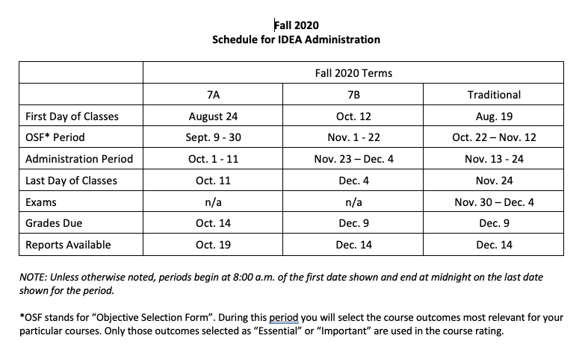
Objective Selection

Slide 13
Gaining a basic understanding of subject (e.g., factual knowledge, methods, principles, generalizations, theories)
Developing knowledge and understanding of diverse perspectives, global awareness, or other cultures
Learning to apply course material (to improve thinking, problem solving, and decisions)
Developing specific skills, competencies, and points of view needed by professionals in the field most closely related to this course
Acquiring skills in working with others as a member of a team
Developing creative capacities (inventing, designing, writing, performing in art, music, drama, etc.)

Slide 14
Gaining a broader understanding and appreciation of intellectual/cultural activity
Developing skill in expressing myself orally or in writing
Learning how to find, evaluate, and use resources to explore a topic in depth
Developing ethical reasoning and/or ethical decision making
Learning to analyze and critically evaluate ideas, arguments, and points of view
Learning to apply knowledge and skills to benefit others or serve the public good
Learning appropriate methods for collecting, analyzing, and interpreting numerical information

Slide 15
Learn more about each Objective https://www.ideaedu.org/idea-notes-on-learning/

Slide 16
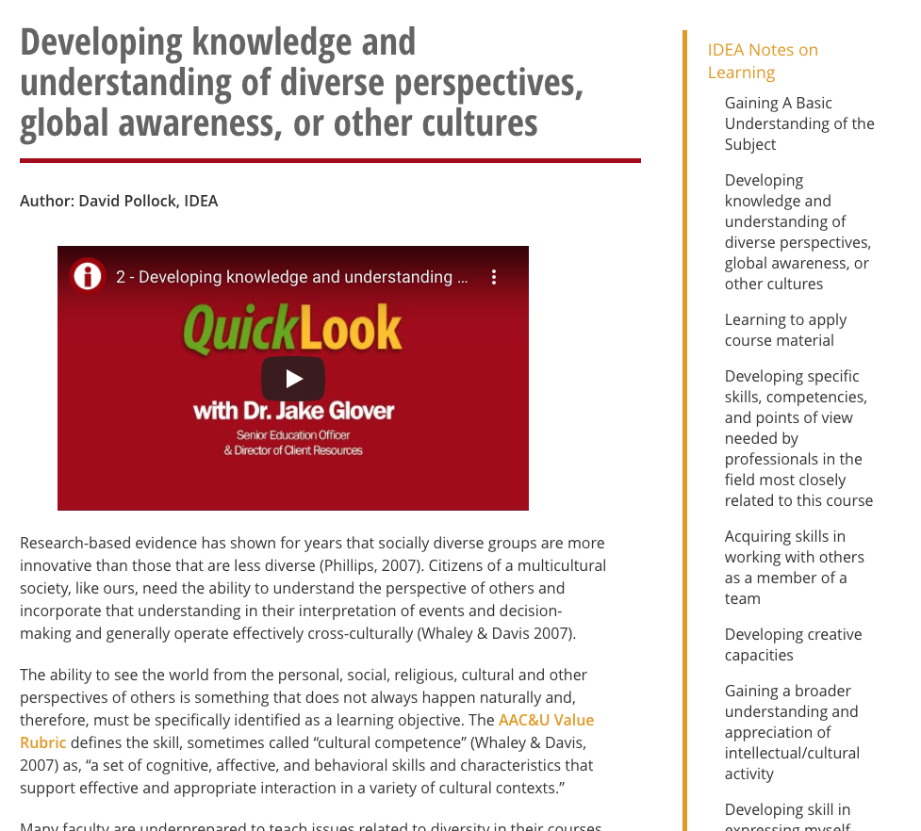
Learn more about each Objective: https://www.ideaedu.org/idea-notes-on-learning/

Slide 17
To log in and choose Objectives…

Slide 18
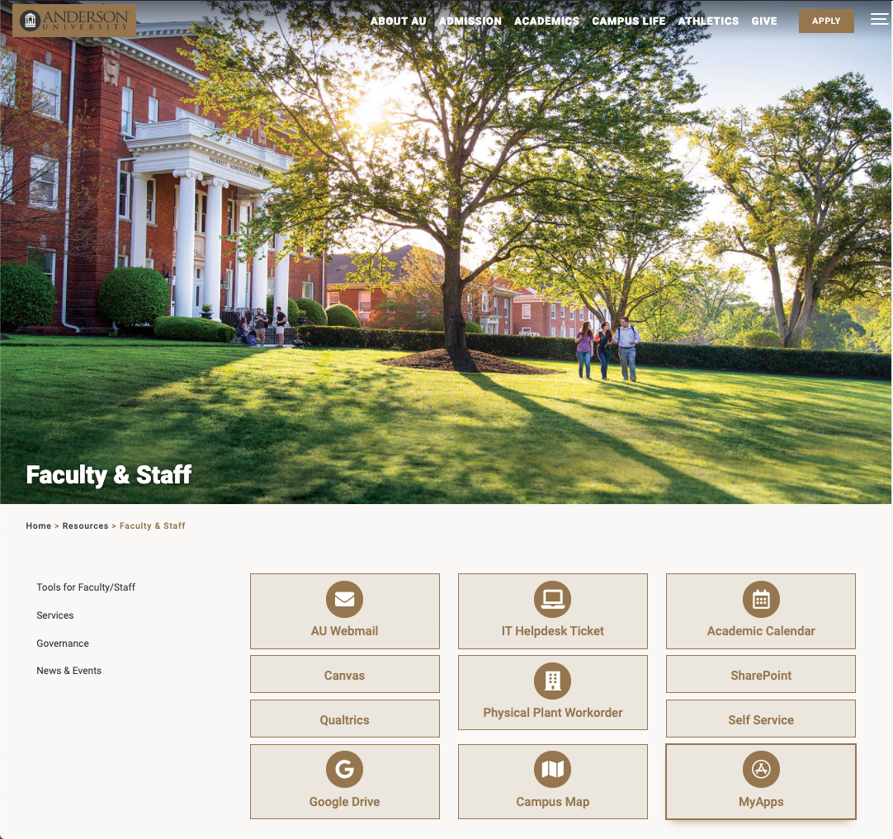

Slide 19
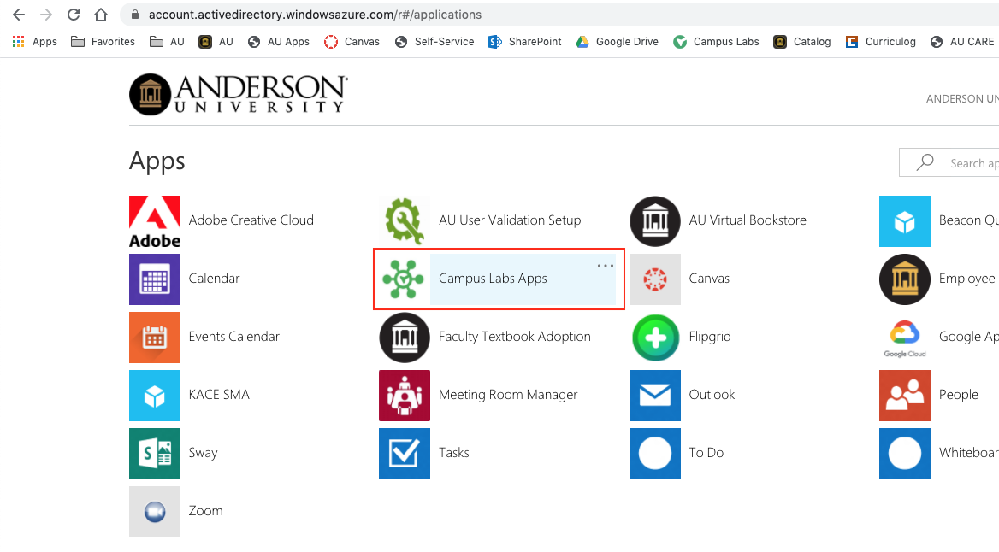

Slide 20
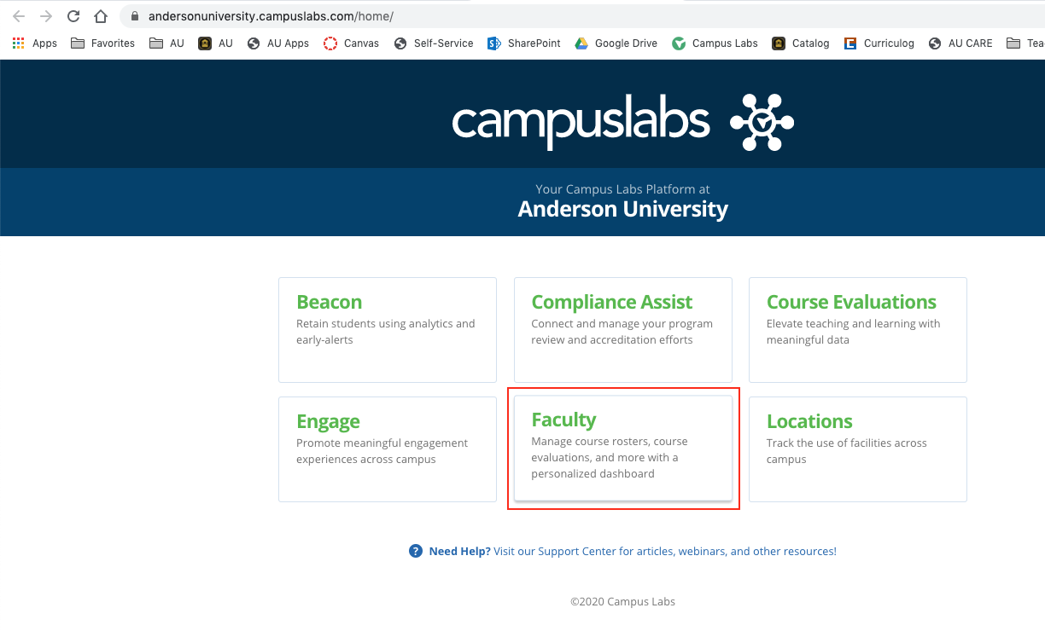

Slide 21
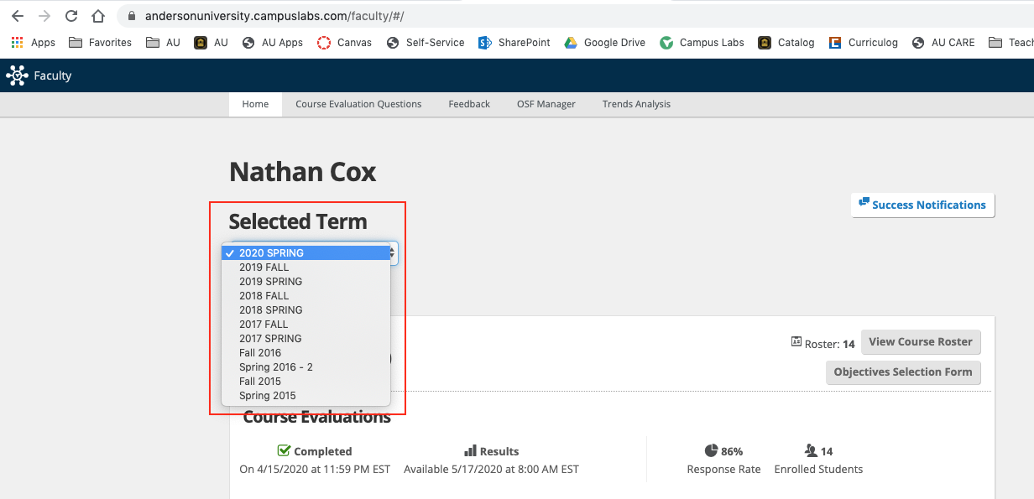

Slide 22
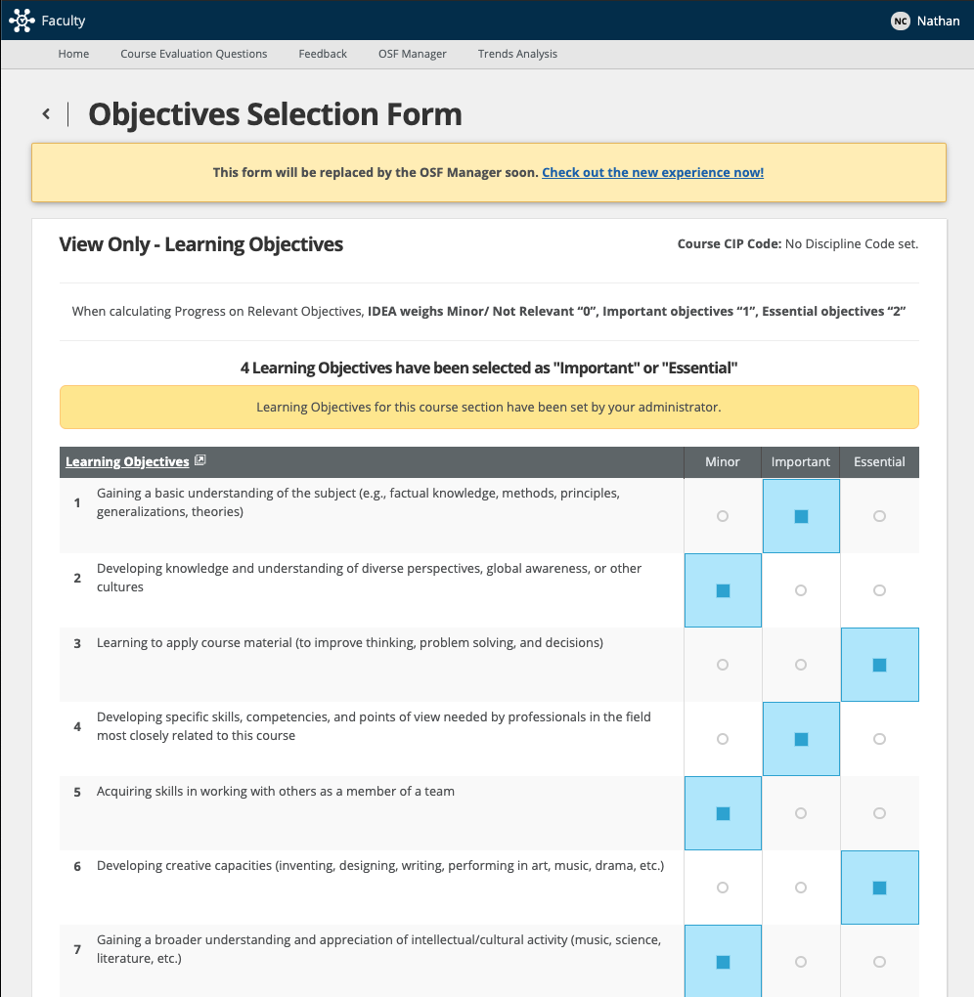
Objectives may already be set

Slide 23
Designate as
• Minor
• Important
• Essential

Slide 24
Designate as
• Minor - no impact
• Important
• Essential - weighted double

Slide 25
3 to 5 total
I or E
• Minor - no impact
• Important
• Essential - weighted double

Slide 26
no more than
2 Essential
• Minor - no impact
• Important
• Essential - weighted double

Slide 27
Valid Participation Rates?

Slide 28
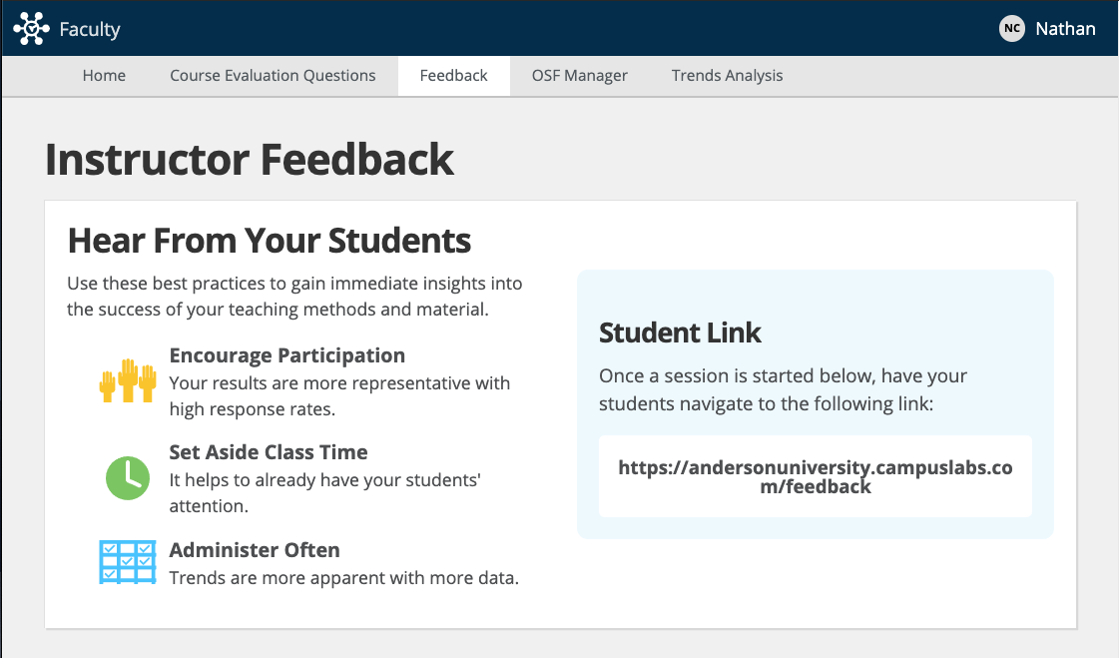
Valid Participation Rates?
IDEA recommends 65%
CLTE recommends 75%

Slide 29
Valid Participation Rates?
Discuss its usefulness.

Slide 30
Valid Participation Rates?
Discuss its usefulness.
Schedule it.

Slide 31
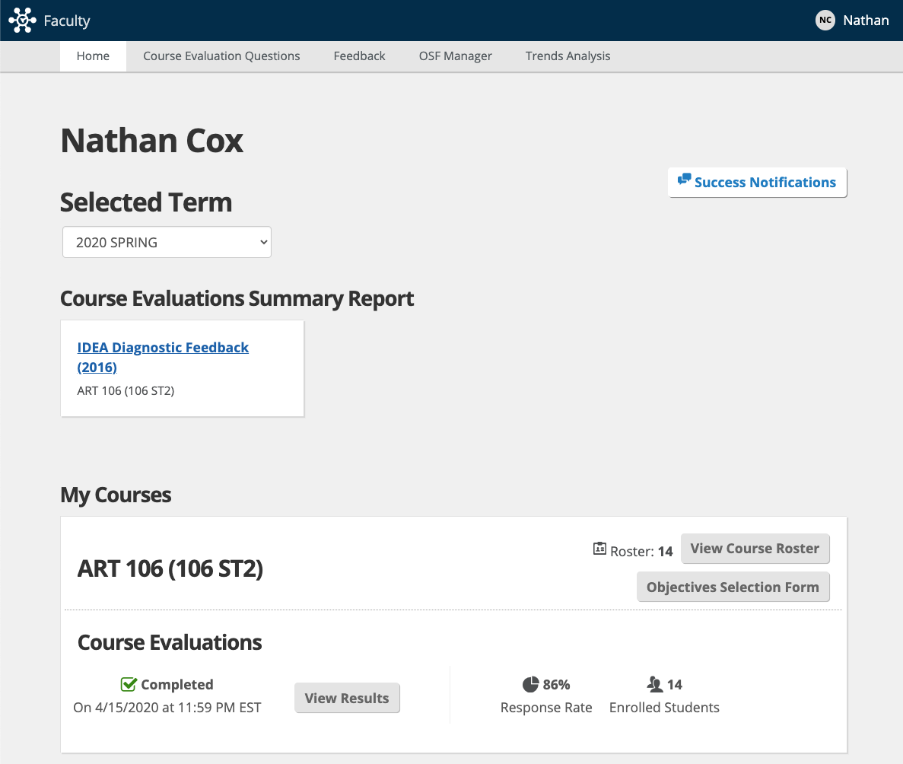
Increasing Participation
Discuss its usefulness.
Schedule it.
Check the Response Rate.

Slide 32
Increasing Participation
Discuss its usefulness.
Schedule it.
Check the Response Rate.
Re-send the link.

Slide 33
Increasing Participation
Discuss its usefulness.
Schedule it.
Check the Response Rate.
Re-send the link.
Incentivize?

Slide 34
Increasing Participation
Discuss its usefulness.
Schedule it.
Check the Response Rate.
Re-send the link.
Incentivize

Slide 35
Interpreting IDEA Results
New Faculty Orientation Workshop 4: Interpreting IDEA Course Ratings
Interpreting results, incorporating teaching improvements and tracking your teaching effectiveness.
Fri. 1/22/2021 (Tentative)

Slide 36
Request an IDEA Consultation https://www.auclte.com/idea-course-rating-interpretation

