Slide 1
Shared governance and Peer Review
An overview of Annual Faculty Performance Reviews
and AU’s
Reappointment, Tenure and Promotion Processes

Slide 2
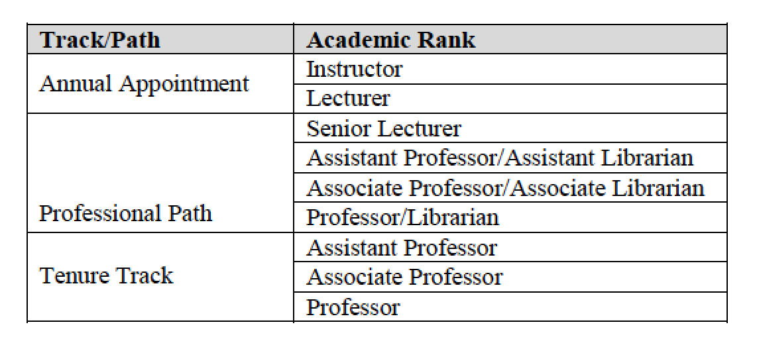
Faculty Classification –
Track and Ranks:
Notes:
https://www.andersonuniversity.edu/hr/handbook
Change of Employment Status: Section 5/5 of handbook.

Slide 3
Obligations of all faculty, regardless of track:
For first 6 years:
Submit a signed annual Faculty Status Reappointment Application.
Create an annual Professional Development Plan (PDP).
(Meet with dean in late summer / early fall - discuss PDP goals.)
Create a portfolio of evidence.
(Collect materials throughout year – including the PDP.)
Have an Annual Performance Review.
(Meet with dean in late spring / summer.)

Slide 4
On What are Faculty evaluated?
What should the PDP and Portfolio Include?
It depends on the position Track…
Notes:
https://www.andersonuniversity.edu/hr/handbook
Change of Employment Status: Section 5/5 of handbook.

Slide 5
Mission Fit Expectations: (for all tracks)
PDP Section I. Mission Fit
Faculty members represent a variety of Christian perspectives.
Individuals may be at different points in their faith journey.
The University affirms that our shared Christian faith is the unique tie that binds us together in this Christian academic community.
Two parts of Section I. …
Notes:
https://www.andersonuniversity.edu/hr/handbook
Change of Employment Status: Section 5/5 of handbook.

Slide 6
Mission Fit Expectations: (for all tracks)
I.A: Mission Fit and Christian Faith in Practice
reflect on how your faith and the University’s mission statement, vision statement, and values are expressed in your personal and professional lives.
explain ways in which you contribute to the advancement of the University’s mission.
Notes:
https://www.andersonuniversity.edu/hr/handbook
Change of Employment Status: Section 5/5 of handbook.

Slide 7
Mission Fit Expectations: (for all tracks)
I.B: Christian Faith and Anderson University’s Statement of Faith
- affirm that you are a confessing Christian who has a personal relationship with Jesus Christ as Savior and Lord and agree annually to respect and undergird the University’s faith statement as you carry out University responsibilities.
Notes:
https://www.andersonuniversity.edu/hr/handbook
Change of Employment Status: Section 5/5 of handbook.

Slide 8
Mission Fit Expectations: (for all tracks)
The University’s Statement of Faith “guides the University’s governance, leadership, and culture, but it is not to be confused with or required as a personal faith statement of individuals for employment.”
There is no “Exceeds Expectations” evaluation on the PDP… Meets Expectations or Not.
Notes:
https://www.andersonuniversity.edu/hr/handbook
Change of Employment Status: Section 5/5 of handbook.

Slide 9
Mission Fit Expectations: (for all tracks)
A chance to revise/expand on/rethink your ideas from employment application statement.
May or may not change much from one year to next.
Contracts include the following:
“Anderson University is a Christian institution of higher learning that has been built upon an enduring faith-based heritage. Faculty members are expected to be respectful of and not undermine the mission, Statement of Faith, vision, values, and purposes of the University.”
Notes:
https://www.andersonuniversity.edu/hr/handbook
Change of Employment Status: Section 5/5 of handbook.

Slide 10
Teaching/Advising Expectations: (for all tracks)
When writing PDP goals…
Refer to lists of types of teaching/advising activities that MEET and EXCEED Expectations (Handbook, 5.6)
Consult with Dean. 3 to 4 goals are plenty.
Notes:
https://www.andersonuniversity.edu/hr/handbook
Change of Employment Status: Section 5/5 of handbook.

Slide 11
Teaching/Advising Expectations: (for all tracks)
Evidence needed in Portfolio:
PDP (with info. on achievement of goals)
Peer Evaluations and your written responses, by course or term:
Teaching Evaluation Classroom Visit Form (seated classes), and/or
Teaching Evaluation Online Course Delivery Review Form (online classes)
Course Ratings and your written responses, by course or term:
IDEA Course Ratings, or
Qualtrix Surveys (Clinical Instructors)
Notes:
https://www.andersonuniversity.edu/hr/handbook
Change of Employment Status: Section 5/5 of handbook.

Slide 12
Service Expectations: (Professional Path and Tenure Track only)
When writing PDP goals…
Refer to lists of types of service activities that MEET and EXCEED Expectations
(Handbook, 5.6)
Consult with Dean. 3 to 4 goals are plenty.
Notes:
https://www.andersonuniversity.edu/hr/handbook
Change of Employment Status: Section 5/5 of handbook.

Slide 13
Service Expectations: (Professional Path and Tenure Track only)
Evidence needed in Portfolio:
PDP (with info. on achievement of goals)
The FSC does not need supplementary info. / documentation beyond the PDP info.
Notes:
https://www.andersonuniversity.edu/hr/handbook
Change of Employment Status: Section 5/5 of handbook.

Slide 14
Scholarship Expectations: (Tenure Track ONLY)
When writing PDP goals…
Refer to lists of types of scholarship activities that MEET and EXCEED Expectations
(Handbook, 5.6)
Refer to Departments’ discipline-specific “Definitions of Scholarship.”
(Academic Affairs Canvas Course or Department)
Consult with Dean. 3 to 4 goals are plenty.
Notes:
https://www.andersonuniversity.edu/hr/handbook
Change of Employment Status: Section 5/5 of handbook.

Slide 15
Scholarship Expectations: (Tenure Track ONLY)
Evidence needed in Portfolio:
PDP (with info. on achievement of goals)
The FSC does not need supplementary info. / documentation beyond the PDP info.
Professional Path faculty engaged in scholarship may optionally document activity on the PDP.
Notes:
https://www.andersonuniversity.edu/hr/handbook
Change of Employment Status: Section 5/5 of handbook.

Slide 16
Professional Path vs. tenure Track:
Professional Path
Evaluated on:
- Mission
- Teaching
- Service
Reappointed annually until year 6, when eligible for reappointment with multi-year contracts.
Tenure Track
Evaluated on:
- Mission
- Teaching
- Service
- Scholarship
Reappointed annually until year 6, when granted Tenure without need for further periodic reappointment.
Notes:
https://www.andersonuniversity.edu/hr/handbook
Change of Employment Status: Section 5/5 of handbook.

Slide 17
Status CHANGEs
Change in Track:
Typically, faculty do not apply to the FSC for Change of Track Status.*
Tracks are designated to the position faculty members hold, determined by the Dean and Provost based on the needs of the academic unit prior to creation of the position.
See:
5.3 “Classification of Faculty Members” and
5.5 “Faculty Change of Status”
for more information.
*
Notes:
https://www.andersonuniversity.edu/hr/handbook
Change of Employment Status: Section 5/5 of handbook.

Slide 18
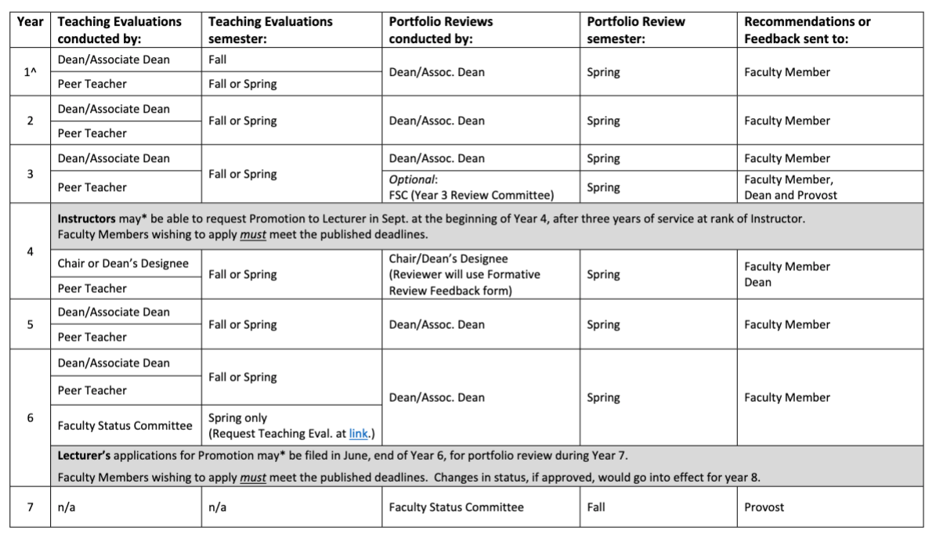
ReVIEW CYCLE: (Annual Appointment track)
Notes:
https://www.andersonuniversity.edu/hr/handbook
Change of Employment Status: Section 5/5 of handbook.

Slide 19
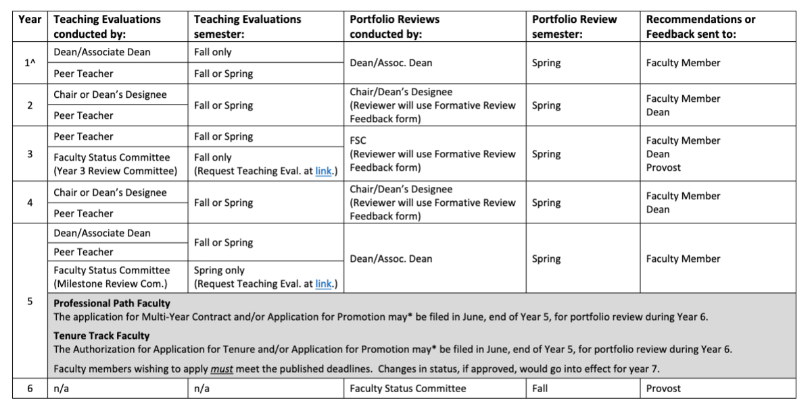
ReVIEW CYCLE: (Professional Path and Tenure Track)
Notes:
https://www.andersonuniversity.edu/hr/handbook
Change of Employment Status: Section 5/5 of handbook.

Slide 20
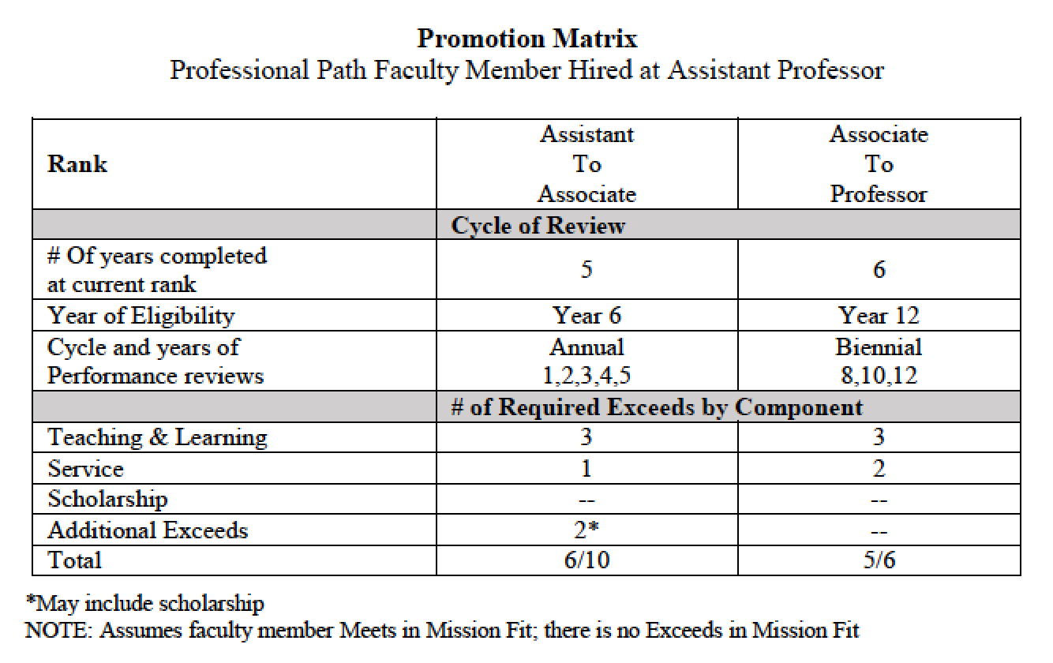
Status CHANGEs
Eligibility for Promotion in Rank:
Promotion Matrix:
(application eligibility)
(One Example…
There are others, depending on track and rank when hired.
See Handbook, 5.6.)
Notes:
https://www.andersonuniversity.edu/hr/handbook
Change of Employment Status: Section 5/5 of handbook.

Slide 21
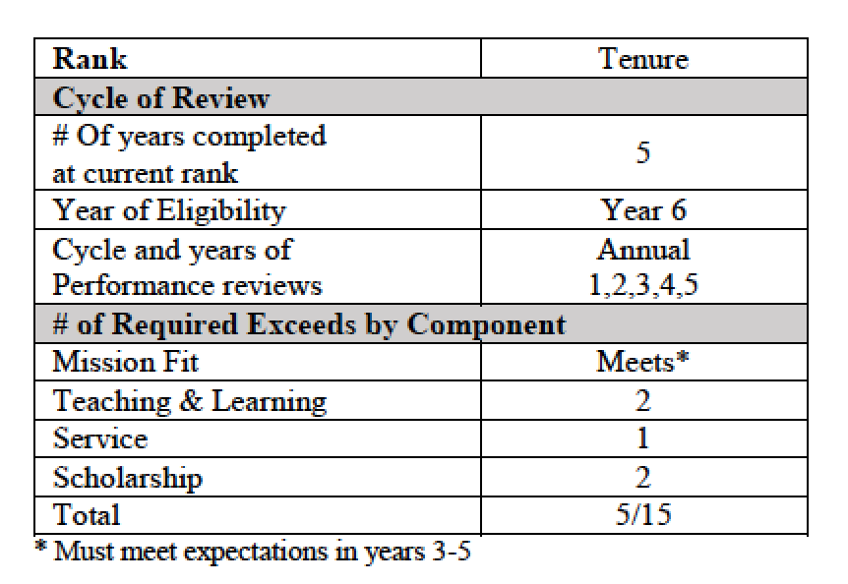
Status CHANGEs
Eligibility for Tenure application:
Tenure Matrix:
(application eligibility)
Eligibility to apply ≠ promotion being awarded or tenure being granted.
Notes:
https://www.andersonuniversity.edu/hr/handbook
Change of Employment Status: Section 5/5 of handbook.

Slide 22
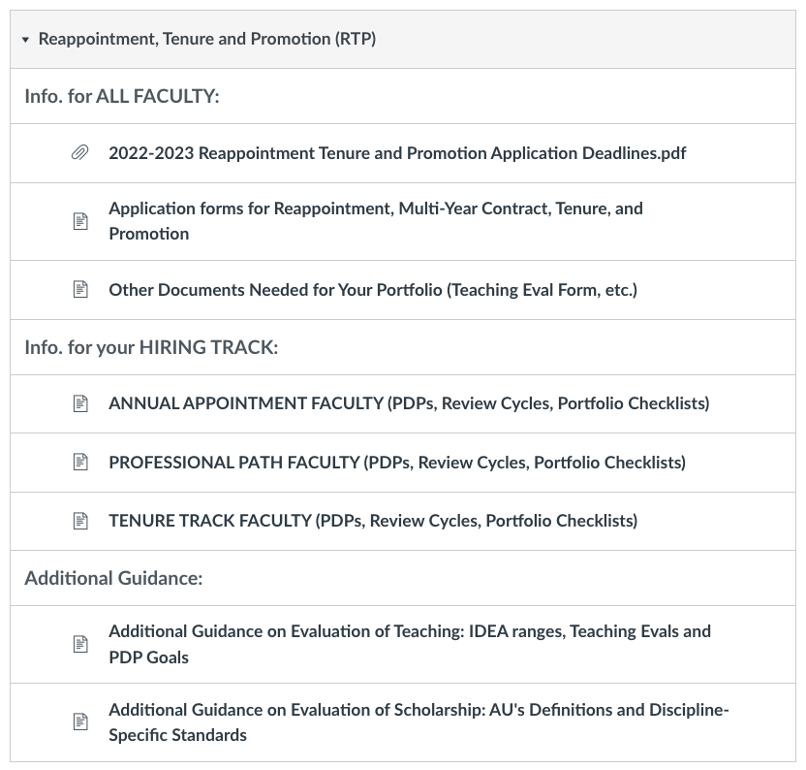
DOCUMENTS and Info. you need:
Choose the correct track info.
Notes:
https://www.andersonuniversity.edu/hr/handbook
Change of Employment Status: Section 5/5 of handbook.

Slide 23
DOCUMENTS and Info. you need:
Mind the deadlines
for your applications.
Notes:
https://www.andersonuniversity.edu/hr/handbook
Change of Employment Status: Section 5/5 of handbook.

Slide 24
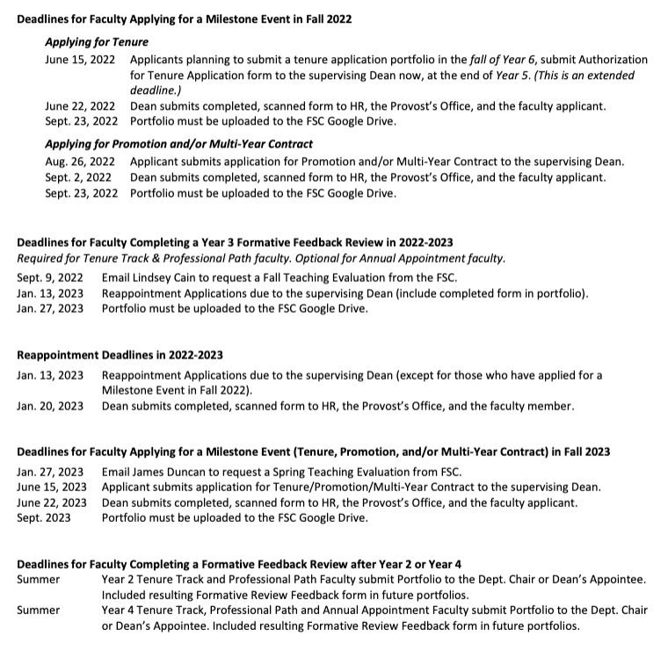
DOCUMENTS and Info. you need:
Mind the deadlines
for your applications.
Notes:
https://www.andersonuniversity.edu/hr/handbook
Change of Employment Status: Section 5/5 of handbook.

Slide 25
DOCUMENTS and Info. you need:
Download the Employee Handbook
www.andersonuniversity.edu/hr/handbook
See sections 5.3, 5.5 and 5.6
Password: “employee”
Get docs from Academic Affairs Canvas Course
https://au.instructure.com/courses/27052
Notes:
https://www.andersonuniversity.edu/hr/handbook
Change of Employment Status: Section 5/5 of handbook.

Slide 26
DOCUMENTS and Info. you need:
Upload your Portfolio on to the secure Google Drive folder:
link in the Academic Affairs Canvas Course
https://au.instructure.com/courses/27052
Notes:
https://www.andersonuniversity.edu/hr/handbook
Change of Employment Status: Section 5/5 of handbook.

Slide 27
Questions?
Seek advice:
- Your Dean (or Assoc. Dean)
- Your Chair
- Faculty Status Committee Chair
(for procedural questions)
Make an appointment:
- Director of the CLTE / Assist. Prov. of Faculty Development, Nathan Cox
Notes:
https://www.andersonuniversity.edu/hr/handbook
Change of Employment Status: Section 5/5 of handbook.

Slide 28
Notes:
https://www.andersonuniversity.edu/hr/handbook
Change of Employment Status: Section 5/5 of handbook.

